Slide 1
ICAEW student scheme (USS)
Moving From student to business professional

Slide 2
USS – what is it?
What: Online toolkit with resources to help you:
Understand which skills/behaviours employers look for
Develop these key skills
Learn how to evidence these on a CV / job application
Develop key digital skills
Xero cloud accounting certificate – NEW
Microsoft Excel training
Interview practice platform – NEW
100 career development videos – NEW
Notes:
There are slides on each of these in this presentation

Slide 3
NEW: Xero cloud accounting certificate
Being Xero certified is becoming a pre-requisite for more and more jobs
Ideal way to learn more about cloud accounting
Takes about six hours to complete – complete it in your own time
12 modules
Learn through real-life scenarios and simulations
You are in role of accountant / you carry out client tasks
Knowledge checks as you learn to help reinforce your learning
You need to complete the Xero course within three months
Notes:
Xero is a world-leading cloud accounting software provider.
The Xero Advisor Certification – Equivalency course = the name of the certificate course provided within the USS offer
See notes above
Across 12 topics, students will learn via real-life client tasks and scenarios including:
Setting up
Contacts
Fixed Assets
Inventory
Projects
Banking
Bills and Purchase Orders
Quotes and Invoices
Expenses
Reporting
Plus learn about Advanced Tools
By the end of the course, students will:
understand the differences and benefits of cloud accounting versus traditional book-keeping
understand how to set up and use Xero on a day-to-day basis
be able to review month end and generate the relevant reports
learn 12 essential topics (see above)
There is an additional 6 hours of free course content if you want to progress beyond the Xero certificate

Slide 4
NEW: Interview platform
Practice psychometric tests and assessment day activities online
Secure, safe platform – your results are only seen by you!
Personality tests
Numerical reasoning
Verbal reasoning
Critical thinking
Situational judgement test (SJT)
And more …
Hurry….only available until 01 September 2019
Notes:
We only have access to this until 01 September 2019!

Slide 5
NEW: 100 career development videos
Get access to 100 career videos eg,
What to do in your first 90 days at work
How to show commercial awareness in your CV/job applications
Skype/video interviews – masterclass
Presenting and public speaking – gain confidence and impact
And lots more….
Hurry…only available until 01 September 2019
Access is limited to the first 1,000 USS students – see USS student website for details
Notes:
We only have access to this until 01 September 2019!

Slide 6
Develop your employability skills – subject examples
Commercial awareness
Teamwork and collaboration
Presentation skills
Resilience
Problem-solving
Emotional intelligence
Communication skills
Transitioning from a student to a professional

Slide 7
Excel training programme
Start with a short test – to gain your Excel IQ score
Start at the level that is relevant to you
Learn through practical exercises, video tutorials and worksheets
Progress at your own pace
Stop and start as often as you like
Take a test at the end to see your improvement score
Add this to your CV and job applications to demonstrate your digital skills competency

Slide 8
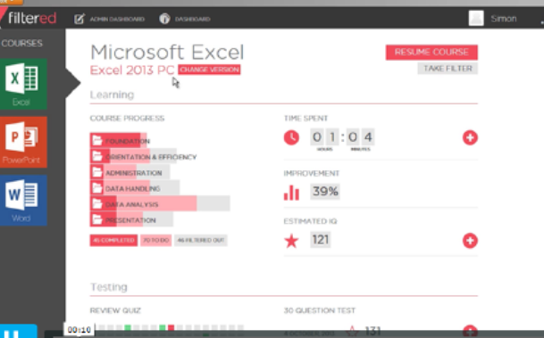
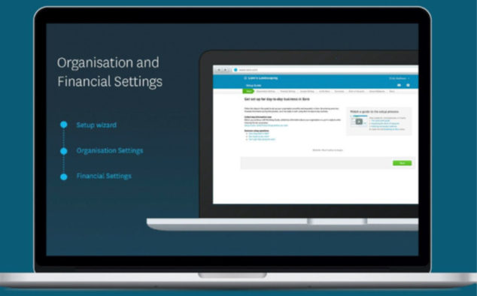
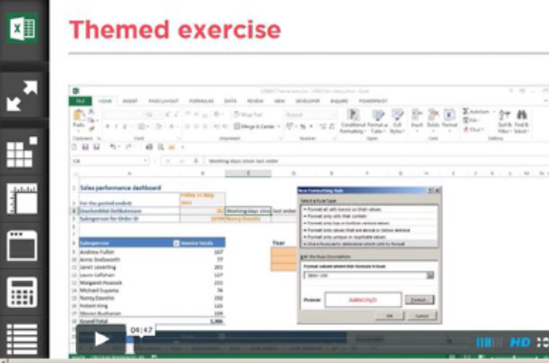
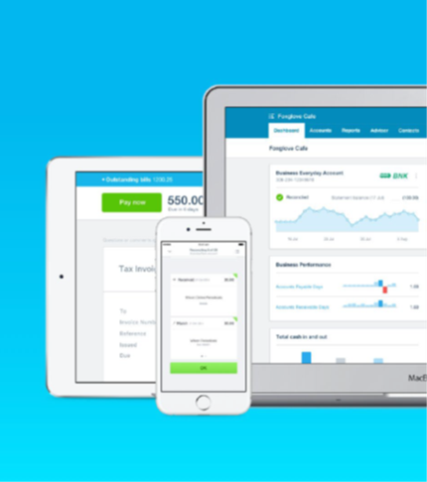
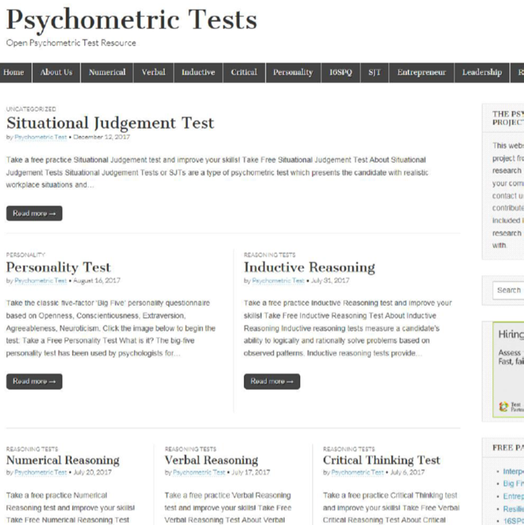
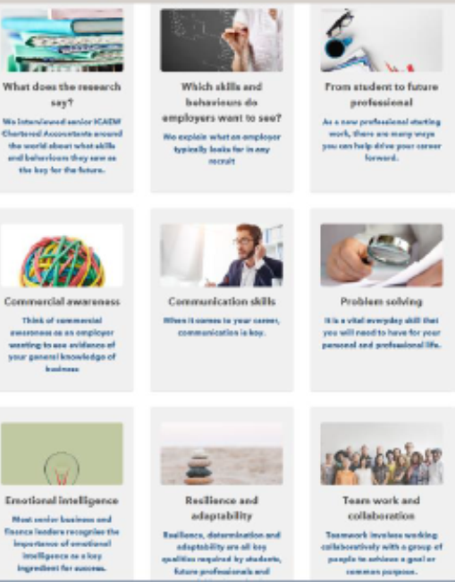
What does it look like?
Xero
Excel
Skills
Interview practice

Slide 9
Benefits and getting started
Benefits – be more employable:
Gain skills that employers are looking for
Helps to increase the range / type of jobs you can apply for
Get ahead of your peers in the job market
Show employers you are dedicated to your career choice
Access lasts throughout university and for 1 year after graduation
How: Register at icaew.com/studentregistration
Enter university code XXXXXXXXX
Enter access code XXXXXXX
Once registered, go to icaew.com/ussstudents to access the benefits

